Slide 1
Recursion backtracking

Slide 2
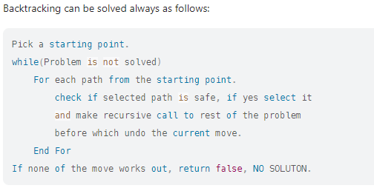

Slide 3
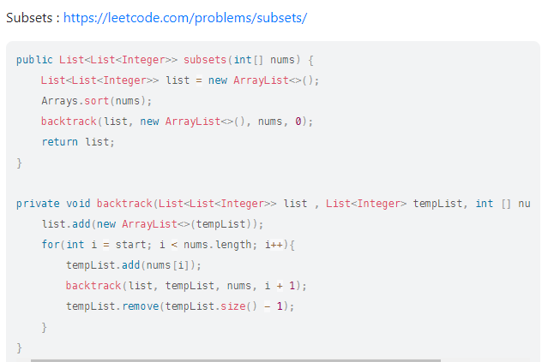
Subsets
https://leetcode.com/problems/subsets/

Slide 4
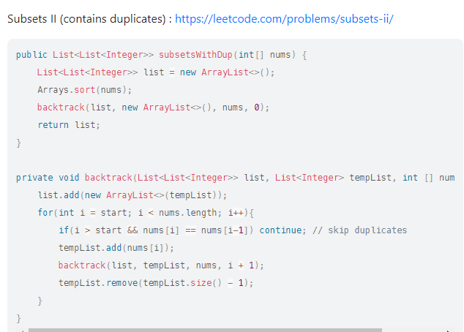
Subsets 2
https://leetcode.com/problems/subsets-ii/

Slide 5
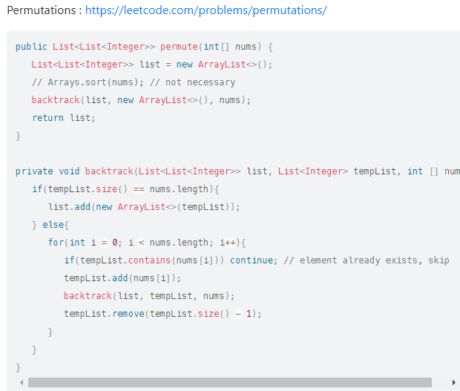
Permutations
https://leetcode.com/problems/permutations/

Slide 6
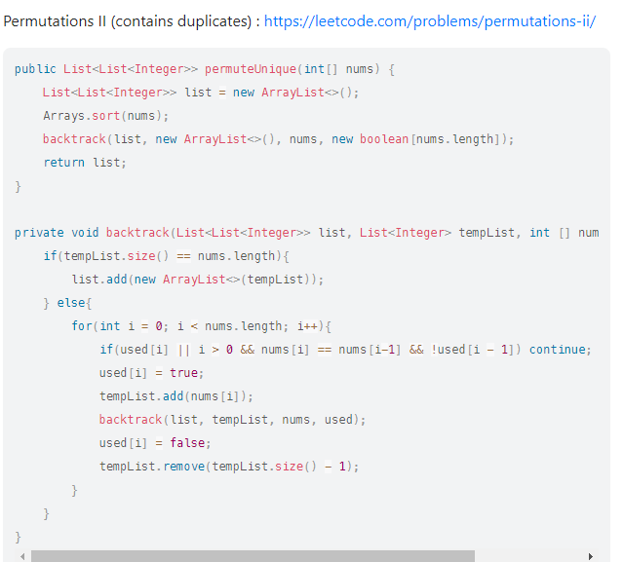
Permutations 2
https://leetcode.com/problems/permutations-ii/

Slide 7
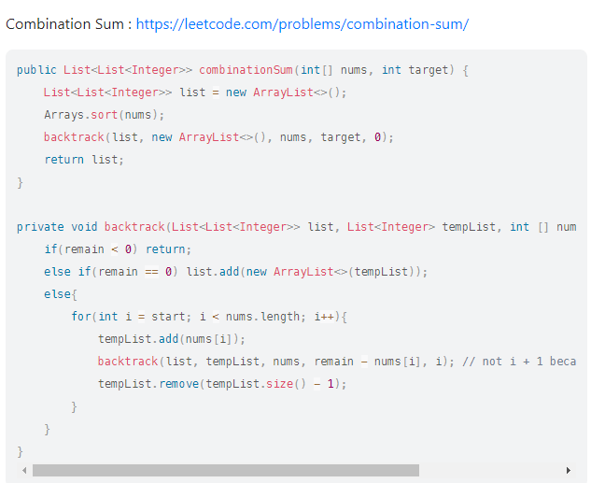
Combination sum
https://leetcode.com/problems/combination-sum/

Slide 8
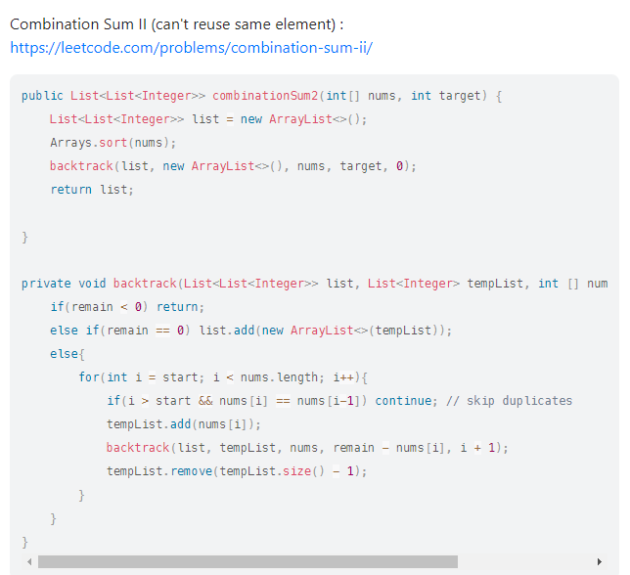
Combination sum 2
https://leetcode.com/problems/combination-sum-ii/

Slide 9
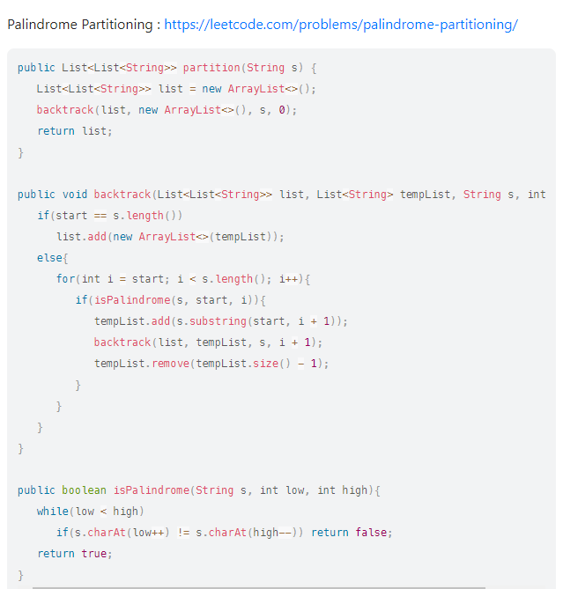
Palindrome partitioning
https://leetcode.com/problems/palindrome-partitioning/

Slide 10
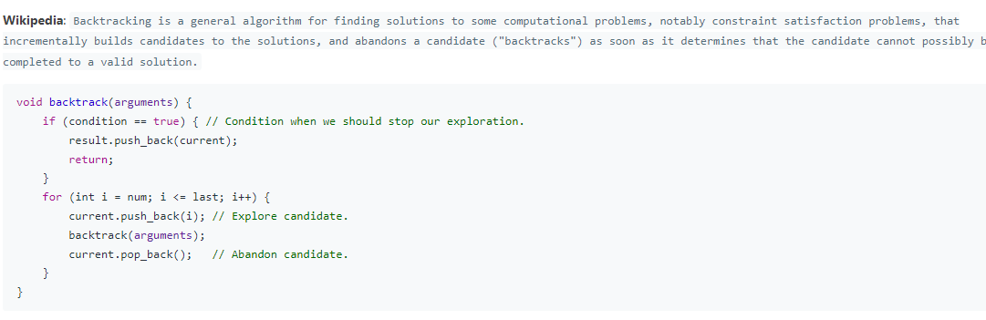

Slide 11
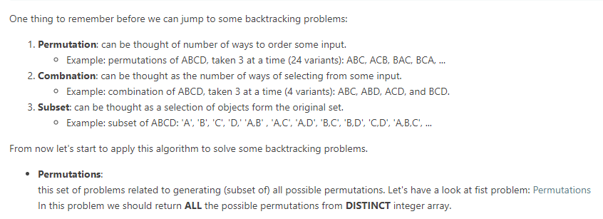

Slide 12
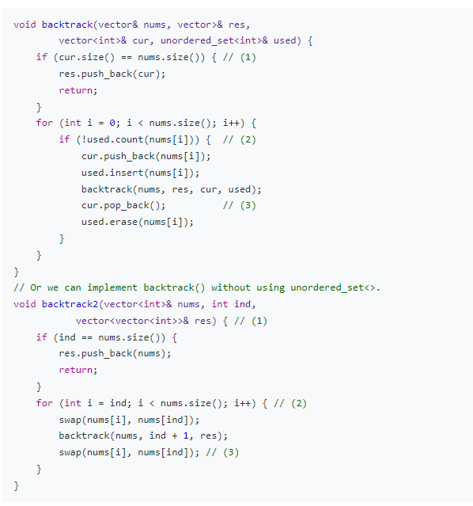

Slide 13
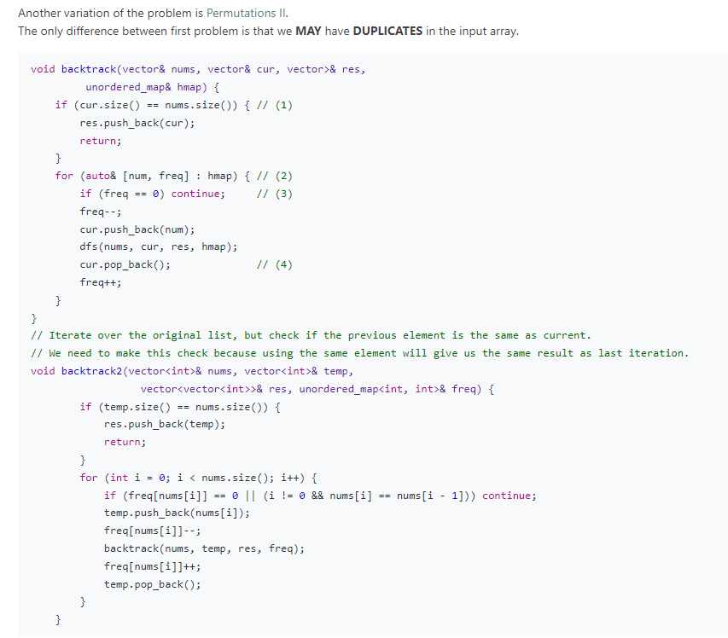

Slide 14
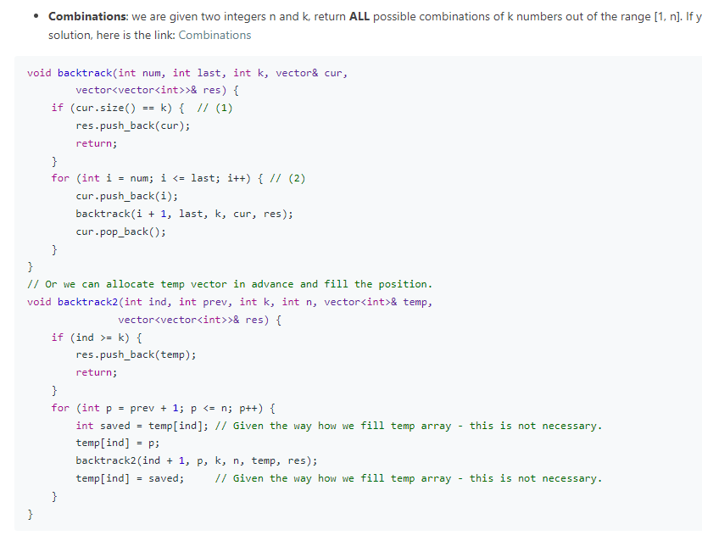

Slide 15
